Slide 1




NEXT GEN EMPLOYABILITY PROGRAM
Creating a future-ready workforce
Team Members
College Name
Student Name : Nikitha Raj P R
Student ID : 311121104041
Loyola ICAM College of Engineering and Technology

Slide 2

CAPSTONE PROJECT SHOWCASE
Project Title
Music Web Application using Django Framework
Abstract | Problem Statement | Project Overview | Proposed Solution | Technology Used | Modelling & Results | Conclusion

Slide 3
Abstract:
This project involves development of a music application using Django. This application will allow users to create accounts, manage music libraries and stream music. Key features include user authentication, a responsive user interface, secure file storage, and a dynamic music player interface. Additionally, the application will utilize Django's built-in ORM for database management and RESTful APIs for seamless integration with frontend technologies.
Source :

Slide 4
Problem Statement
Creation of Music Web Application using Django Framework
Source :

Slide 5
Project Overview
This project aims to develop a modern and user-friendly music streaming application using Django. The application will enable users to create personalized accounts, manage their music collections, and enjoy seamless streaming of their favorite tracks. Key features include user authentication, responsive design for various devices, secure file storage, and an intuitive music player interface. Leveraging Django's ORM and RESTful APIs, our goal is to deliver a reliable platform that enhances the music listening experience for all users.
Source :

Slide 6
Proposed Solution
Our solution involves building a music streaming application using Django, integrating essential features like user authentication, music upload and management, and a responsive music player. We will implement secure file storage for user uploads and ensure compatibility across different devices through responsive design. The use of Django's ORM will facilitate efficient database management, while RESTful APIs will enable seamless communication with the frontend. Our aim is to create a streamlined and enjoyable music streaming experience for users, emphasizing simplicity and functionality.
Source :

Slide 7


Technology Used
Front-end
Back-end
Source :

Slide 8
Modelling & Results
The project will involve designing a Django data model to represent users, music tracks, and playlists. Utilizing Django's ORM, we'll ensure efficient data storage and retrieval. User authentication will be implemented using Django's built-in authentication system. For the frontend, responsive templates will be created using HTML, CSS and JavaScript for seamless user interaction. The music streaming functionality will be achieved using Django's file handling capabilities and a custom music player interface.
Source :

Slide 9
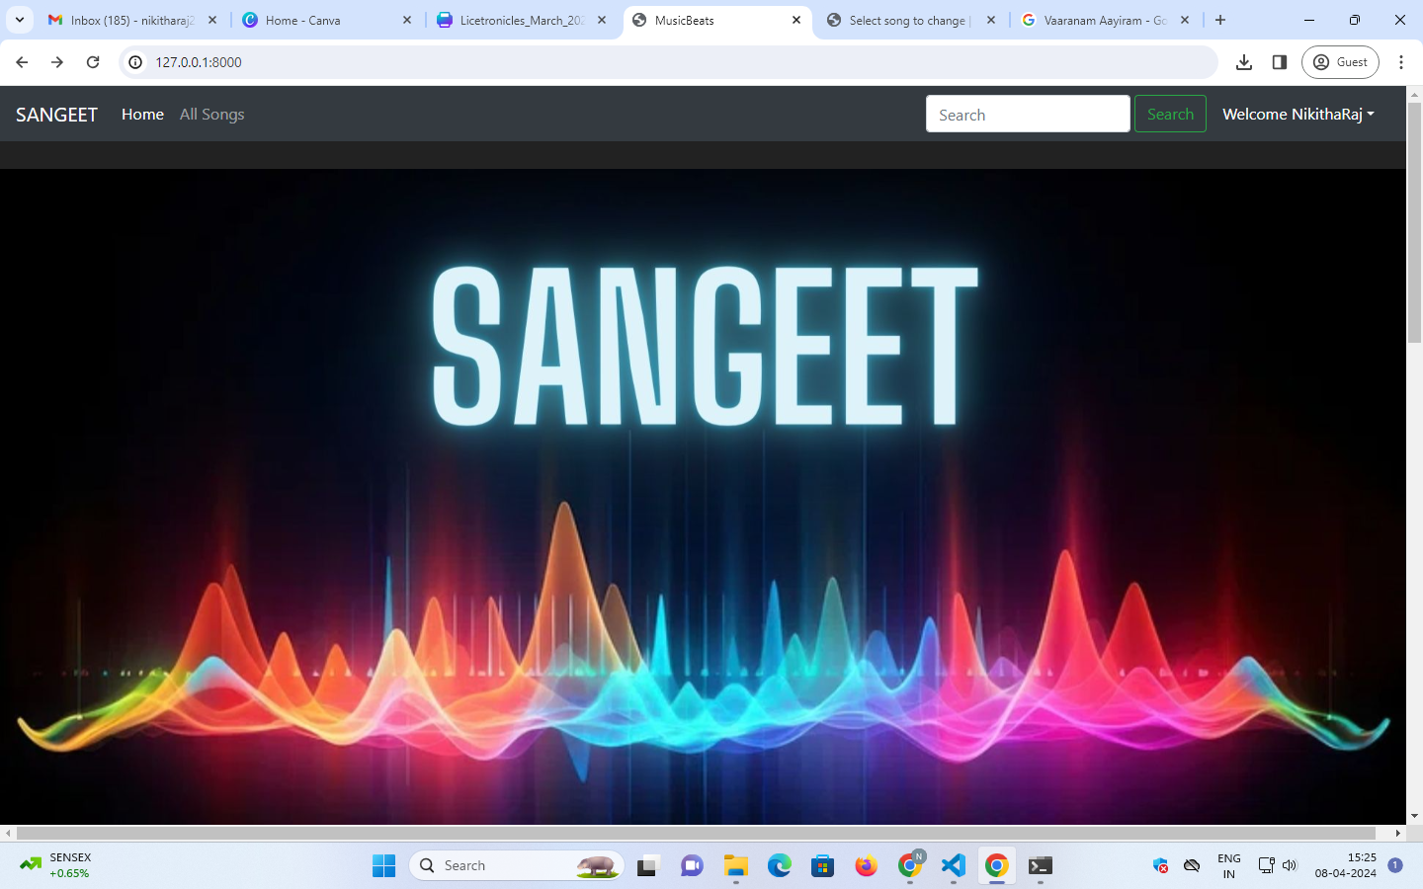
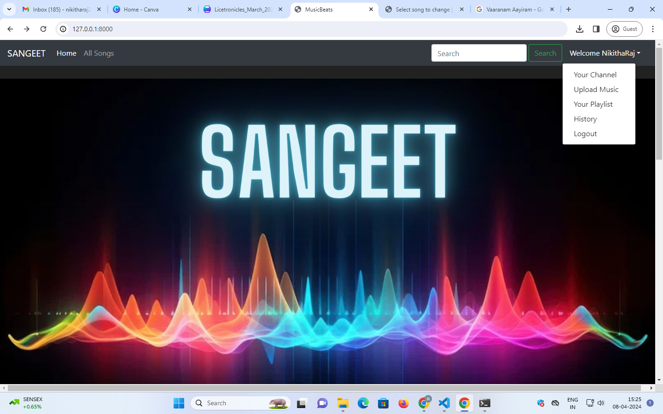
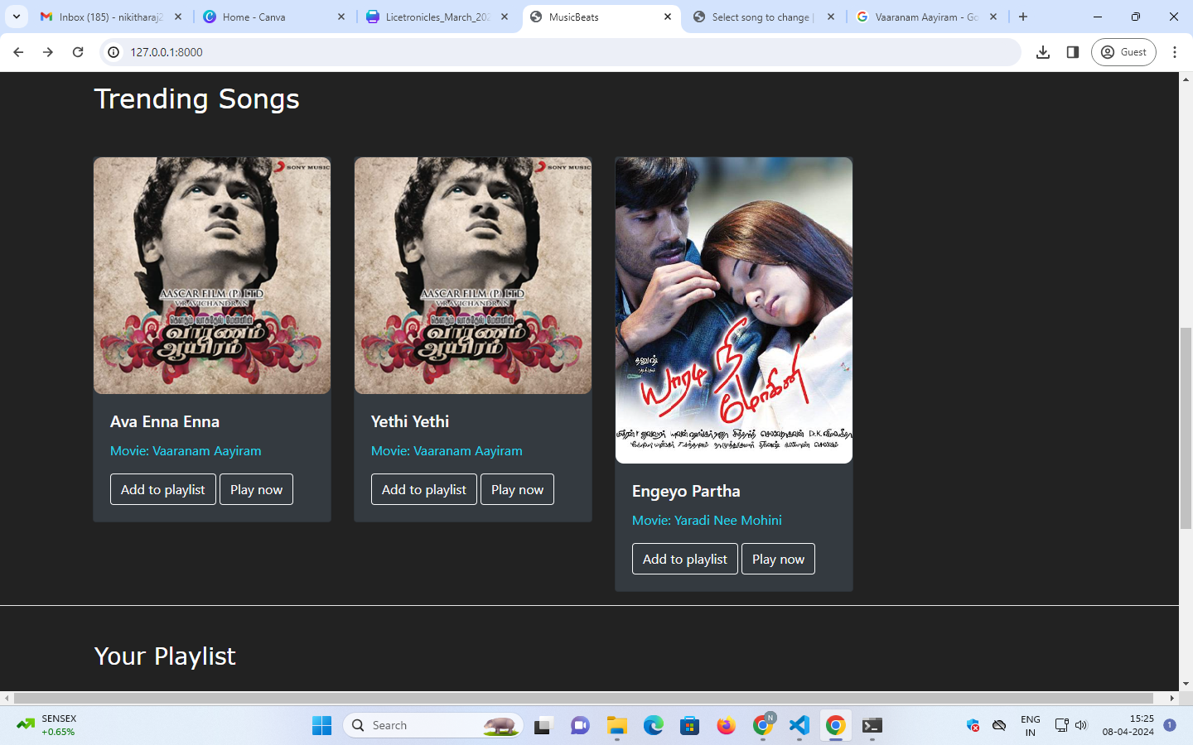
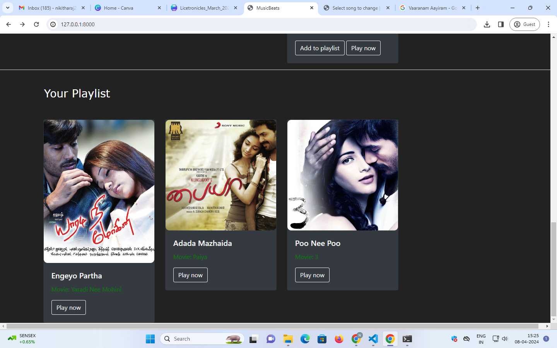
Homepage

Slide 10
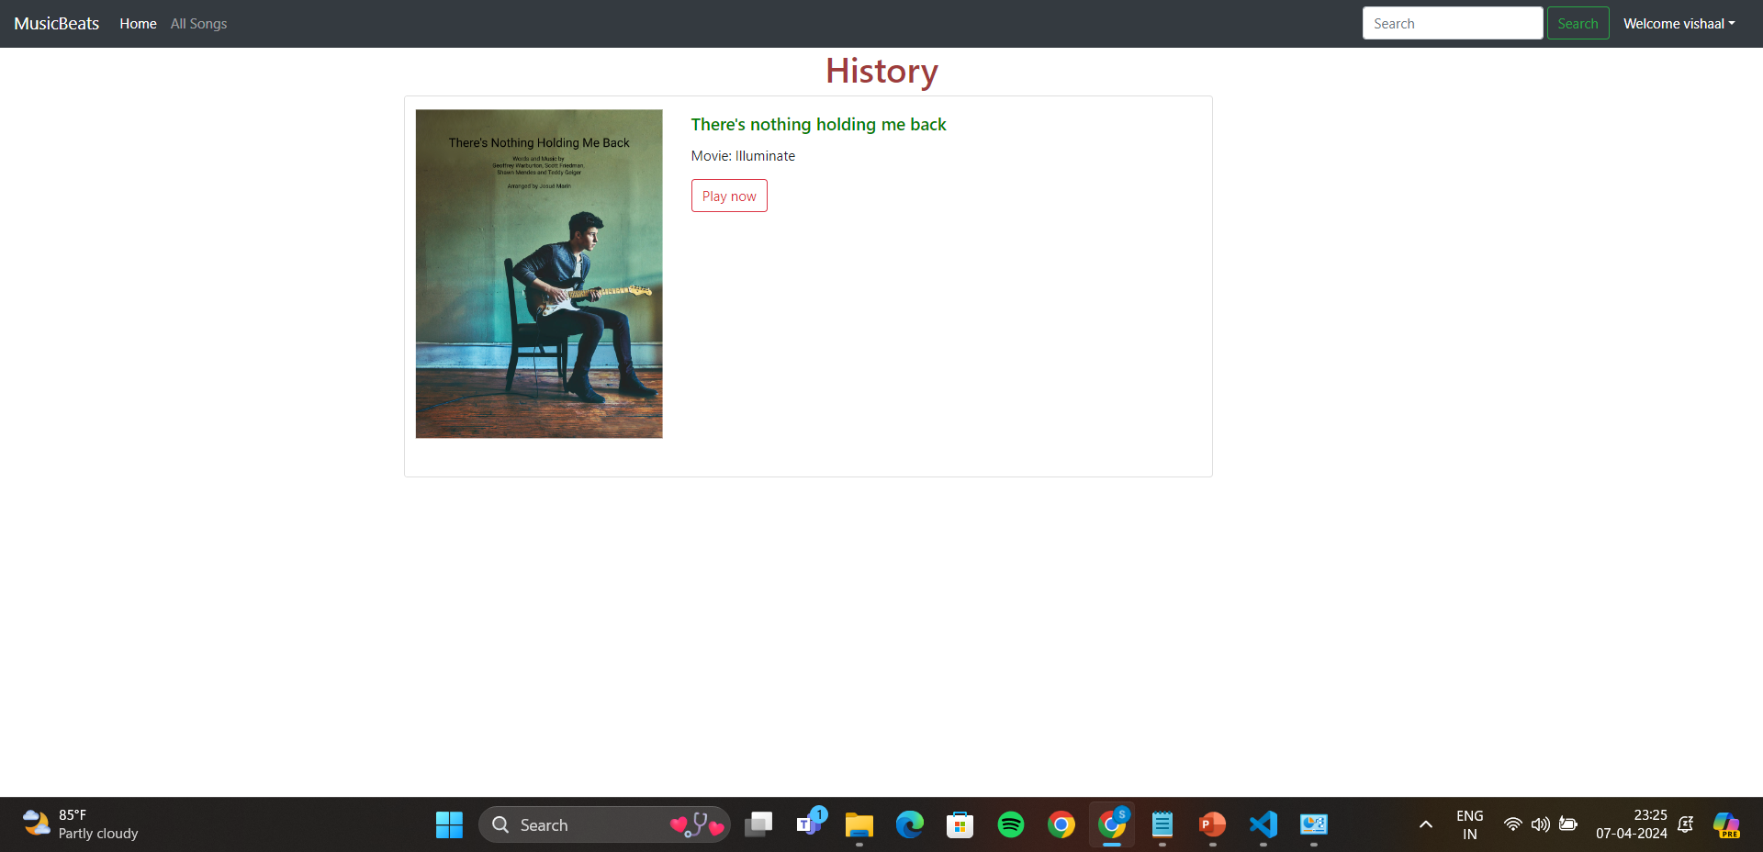
History Page

Slide 11
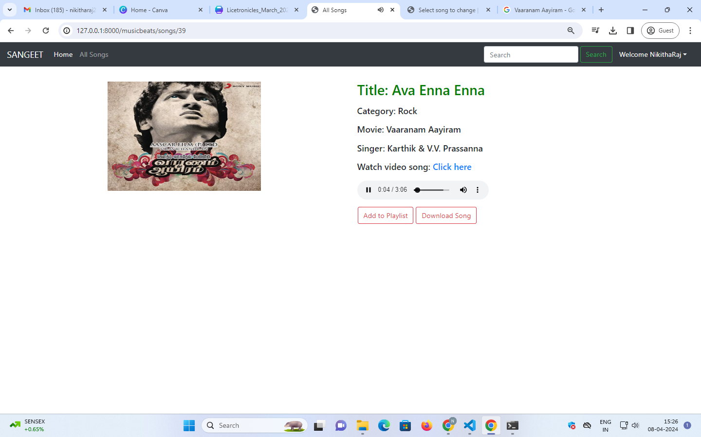
Audio Player Page

Slide 12
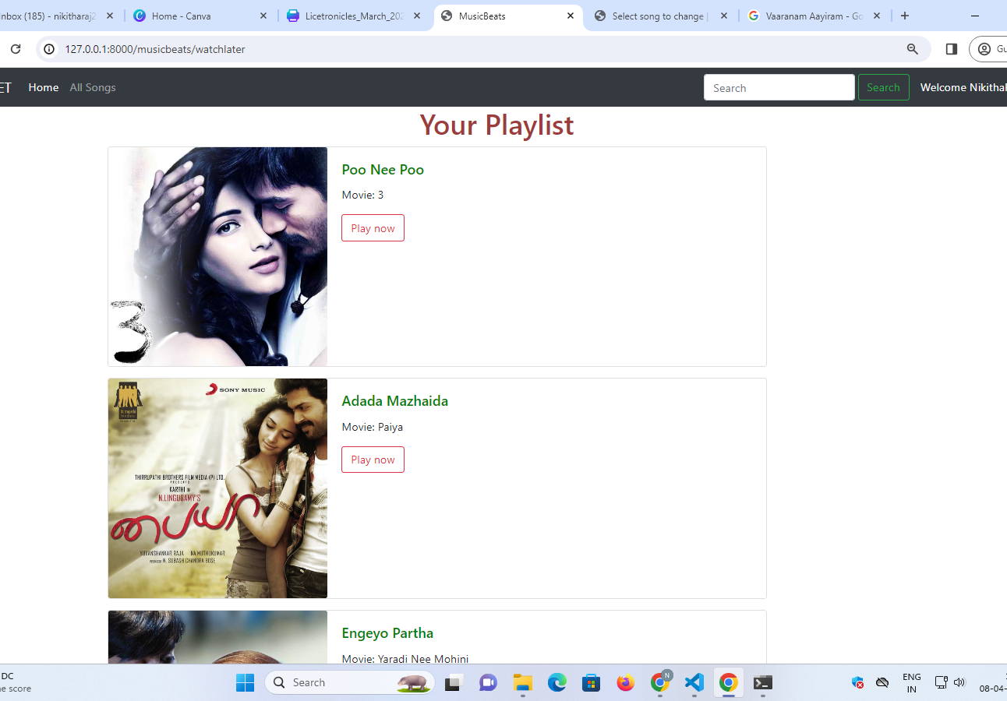
Playlist Page

Slide 13
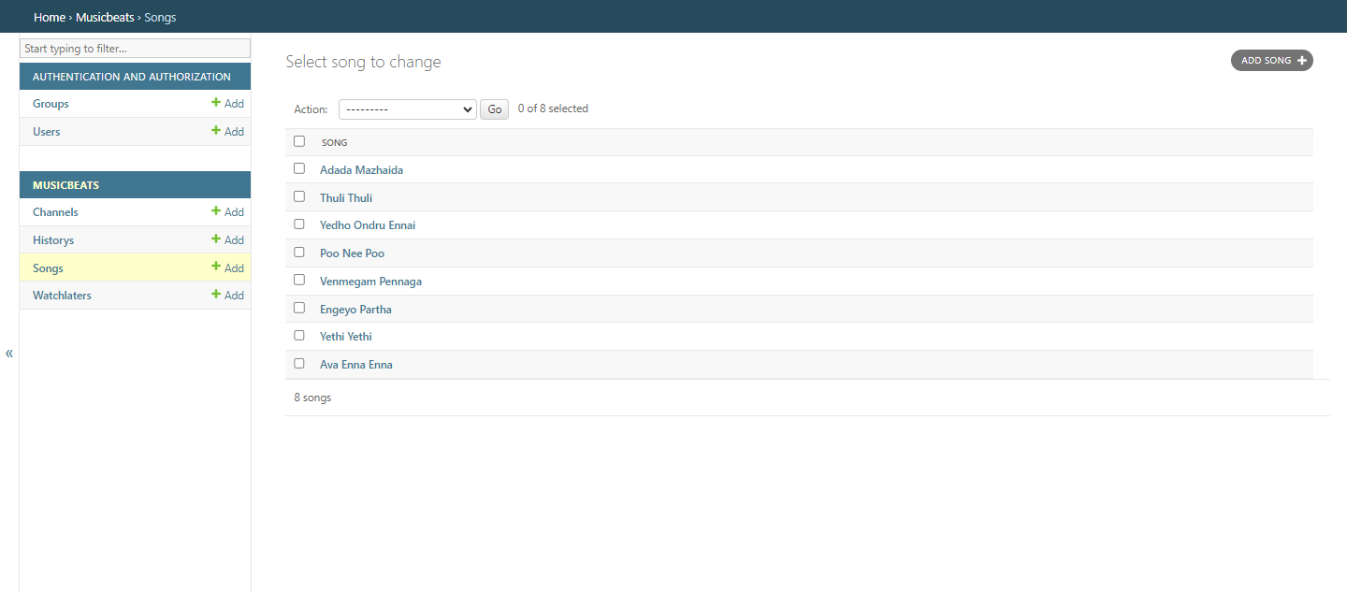
Backend Admin Page

Slide 14
Songs List

Slide 15
Future Enhancements:
In the future, we could implement features such as personalized recommendations based on listening history, social sharing of playlists, integration with external music APIs for expanded content access, and support for offline playback. We could also enhance the user interface with more interactive elements. Continuous performance optimization and scalability improvements could also be done for growing user base.

Slide 16
Conclusion:
In conclusion, this Django-based music streaming application presents a scalable and feature-rich platform for music enthusiasts. By leveraging Django's robust framework, I have developed a responsive and secure solution that prioritizes user experience. With planned future enhancements, we are committed to evolving this application to meet the dynamic demands of music streaming while maintaining a seamless and enjoyable experience for our users.

Slide 17
Thank You!
Notes:
Thank You !!

